Slide 1
Excel Simulator Tips & Tricks
2019 SAWTOOTH SOFTWARE CONFERENCE

Slide 2
Additional Files
https://github.com/kpfairchild/ExcelSimulator

Slide 3
Topics we’ll cover
Why Excel?
Essential Calculations
Segmentation and Weighting
Style Considerations
Array Formulas
Named Ranges
Putting it all Together

Slide 4
Why Excel?
We have lots of simulator options:
Lighthouse - Most powerful
sawtoothsimulator.com - Most online!
Lighthouse Excel export - Easy option, less flexible, not client ready
Custom Excel Simulator – Fully customizable, easy to give to clients

Slide 5
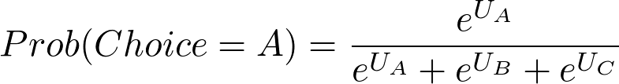
Essential Calculations
Total Utility Calculation:
Share of Preference:

Slide 6
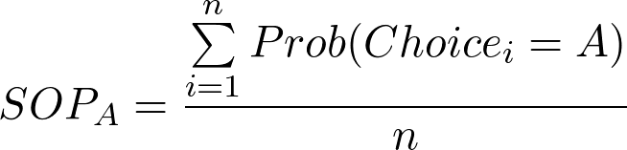
Essential Calculations
Average Share of Preference:
Notes:
Average share of preference is just the average over each respondent’s share of preference.

Slide 7
Segmentation and Weighting
Segmentation – Filtering of respondents by known subgroups
Weighting – Changing respondent’s relative contribution toward group average
Use weighting when your actual population is different in a known way from your sampled population.

Slide 8
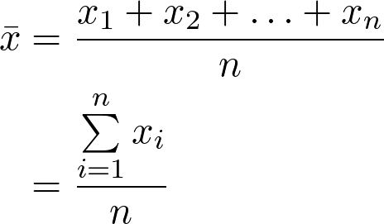
Segmentation and Weighting – Review Averages
Regular Average:

Slide 9
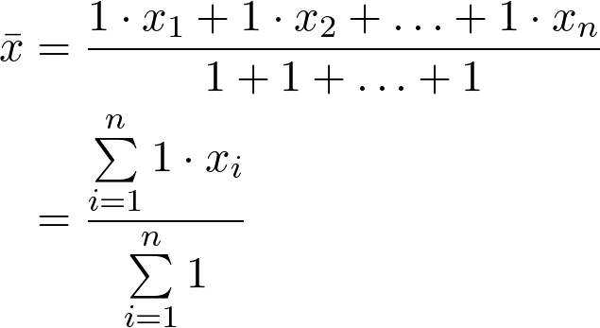
Segmentation and Weighting – Review Averages
Regular Average with weights shown:

Slide 10
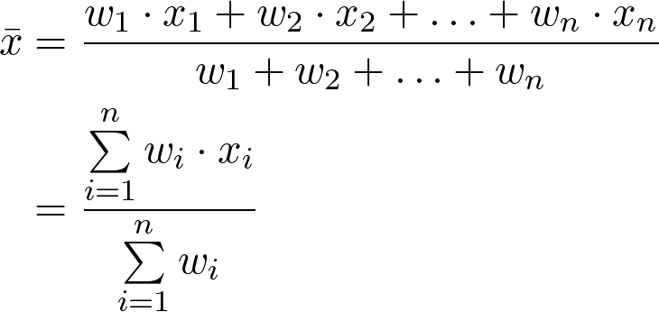
Segmentation and Weighting – Review Averages
Weighted Average with weights shown:

Slide 11
Segmentation and Weighting – Segmentation
For building our simulators, segmentation is a matter of setting our weights equal to zero when the segment should be excluded.

Slide 12
Style Considerations

Slide 13
Array Formulas
Allows operations on many cells at once
Allows ‘arrays’ of cells to operate on each other
Control+Shift+Enter
F9

Slide 14
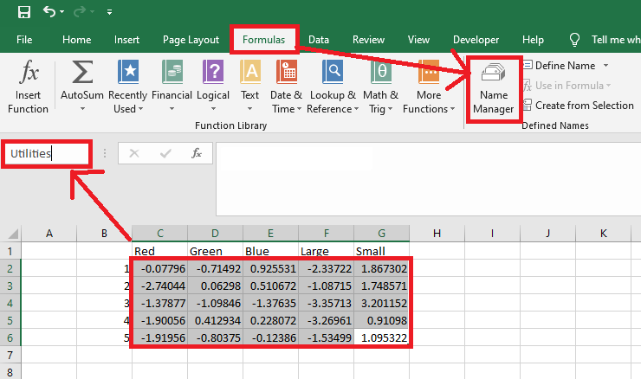
Named Ranges – Reuse common cell selections

Slide 15
QUESTIONS?
kenneth@sawtoothsoftware.com
www.sawtoothsoftware.com
+1 801 477 4700

